Slide 1
WT-XAFS
Rafat Hossain Aunkon

Slide 2
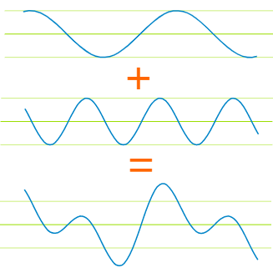
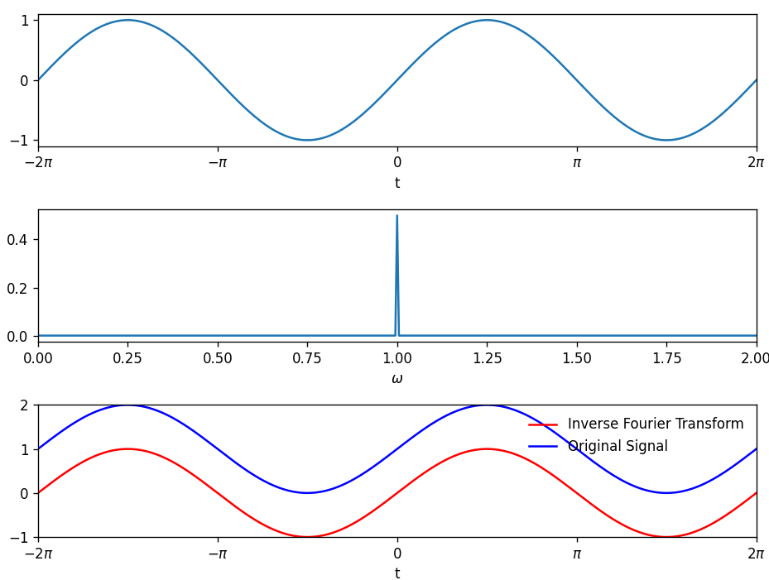
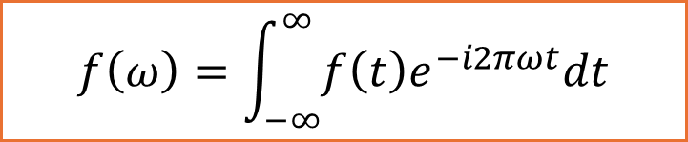
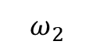
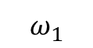
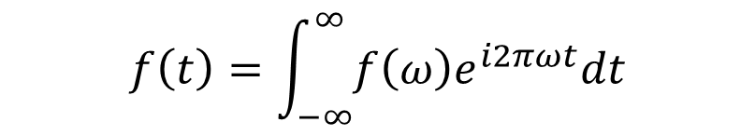
Decompose a wave
$$ω_{1}$$
frequency
$$f\left(ω\right)=\int_{−∞}^{∞}{f\left(t\right)e^{−i2πωt}dt}$$
low
$$ω_{2}$$
Basis functions are cosine and sine
high
$$f\left(t\right)=A_{1}\cos\left(ω_{1}t\right)+A_{2}\cos\left(ω_{2}t\right)+…$$
$$f\left(t\right)=\int_{−∞}^{∞}{f\left(ω\right)e^{i2πωt}dt}$$
Linear combination of several of Sine and cosine waves
Notes:
On this slide, we’re illustrating how any time-domain signal can be broken down into simpler sinusoidal components. The transform works by projecting f(t)f(t)f(t) onto sine and cosine (or complex exponential) basis functions. Below, the first plot is our original time-domain waveform.
The middle plot shows its frequency spectrum: a single spike at the dominant frequency of the signal.
That peak tells us exactly which sinusoid makes up the waveform. Finally, the inverse Fourier transform can bring the signal back

Slide 3
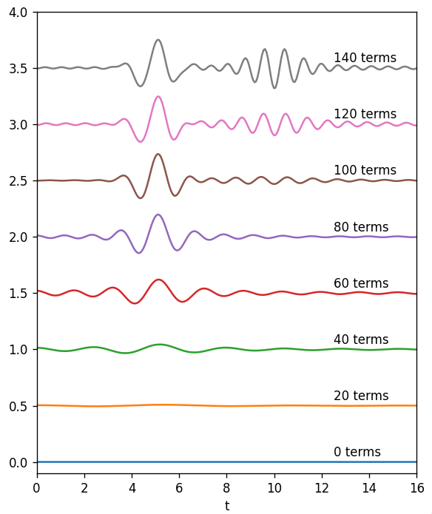
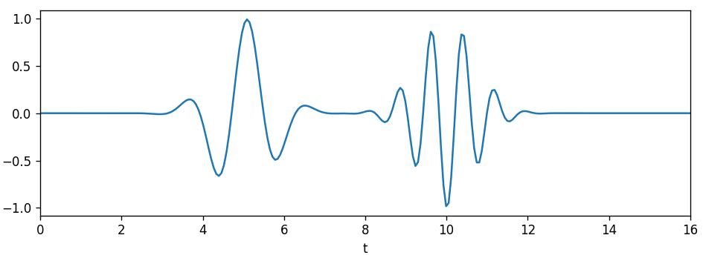
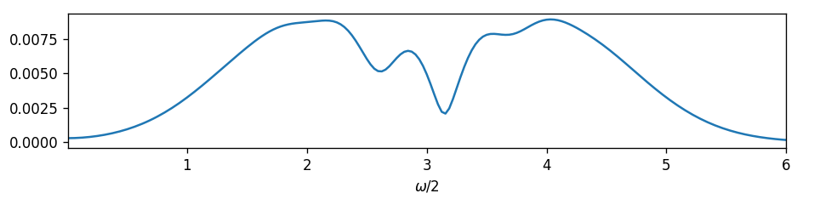
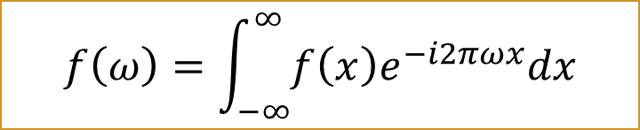
Fourier transform: two example(II)
$$f\left(ω\right)=\int_{−∞}^{∞}{f\left(x\right)e^{−i2πωx}dx}$$
reconstruct by using a set of cosine function:
$$f\left(x\right)=A_{1}\cos\left(ω_{1}x\right)+A_{2}\cos\left(ω_{2}x\right)+…$$
$$χ\left(t\right)=\sin\left(4t\right)e^{−{\left(t−5\right)}^{2}}\sin\left(8t\right)e^{−{\left(t−10\right)}^{2}}$$
Reconstruct
There is no information in t space
Janis Timoshenko et al. Computer Physics Communications 180 (2009) 920–925
Notes:
You learn which frequencies are present—but not when they occur in time. Fourier allows perfect reconstruction. However, there is not time information . It is due to time –frequency uncertainty. If you a have high resolution in time domain , you will have poor resolution in frequency domain. So we need find a compromise. Which motivates time–frequency methods (e.g.\ wavelets) when you need both time and frequency resolution. Maybe not with super good resolution but decent enough.

Slide 4
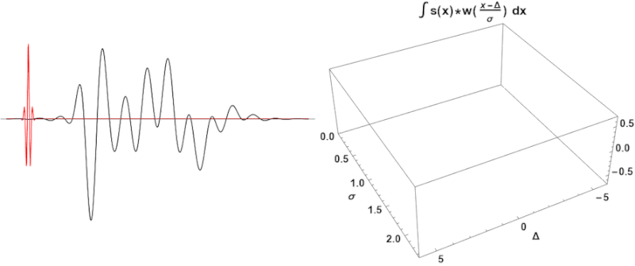
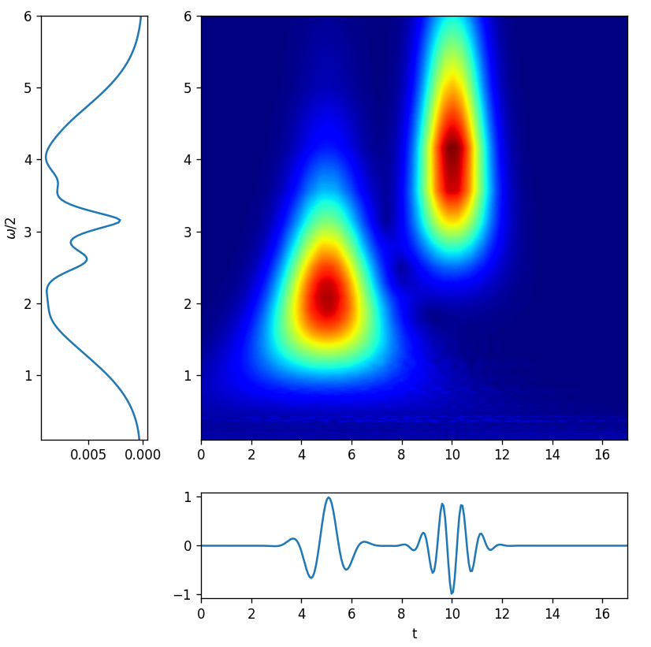
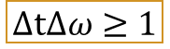
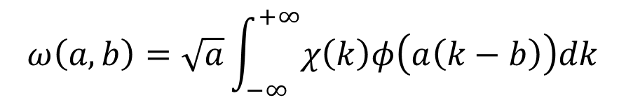
Wavelet transform(CWT)
$$ω\left(a,b\right)=\sqrt{a}\int_{−∞}^{+∞}{χ\left(k\right)φ\left(a\left(k−b\right)\right)dk}$$
$$χ\left(t\right)=\sin\left(4t\right)e^{−{\left(t−5\right)}^{2}}\sin\left(8t\right)e^{−{\left(t−10\right)}^{2}}$$
https://commons.wikimedia.org/wiki/File:Continuous_wavelet_transform.gif
Scaling(a)
Translation(b)
It can have resolution in t and frequency space
Tradeoff
$$ΔtΔω≥1$$
Notes:
That 2D map is your wavelet fingerprint

Slide 5
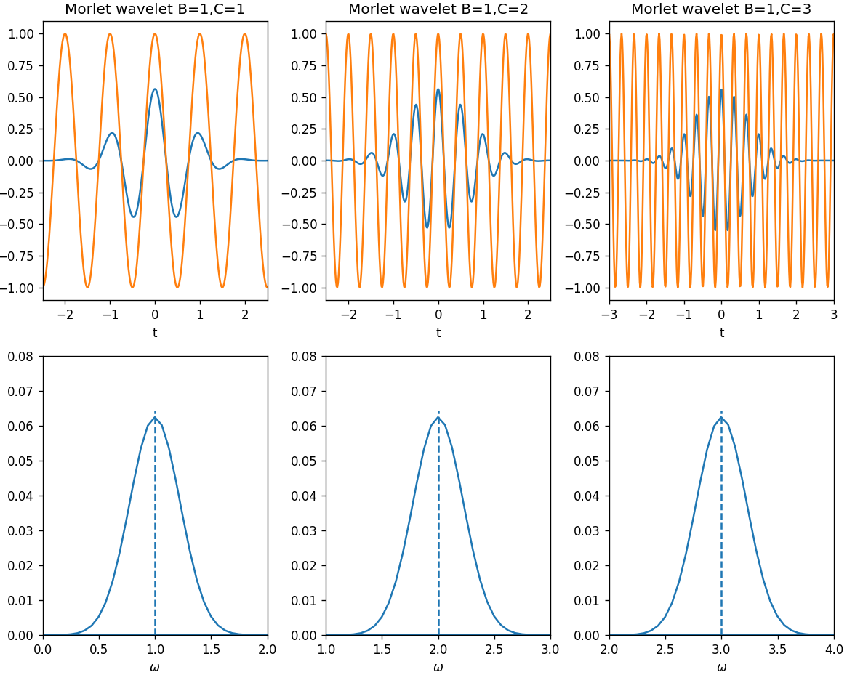
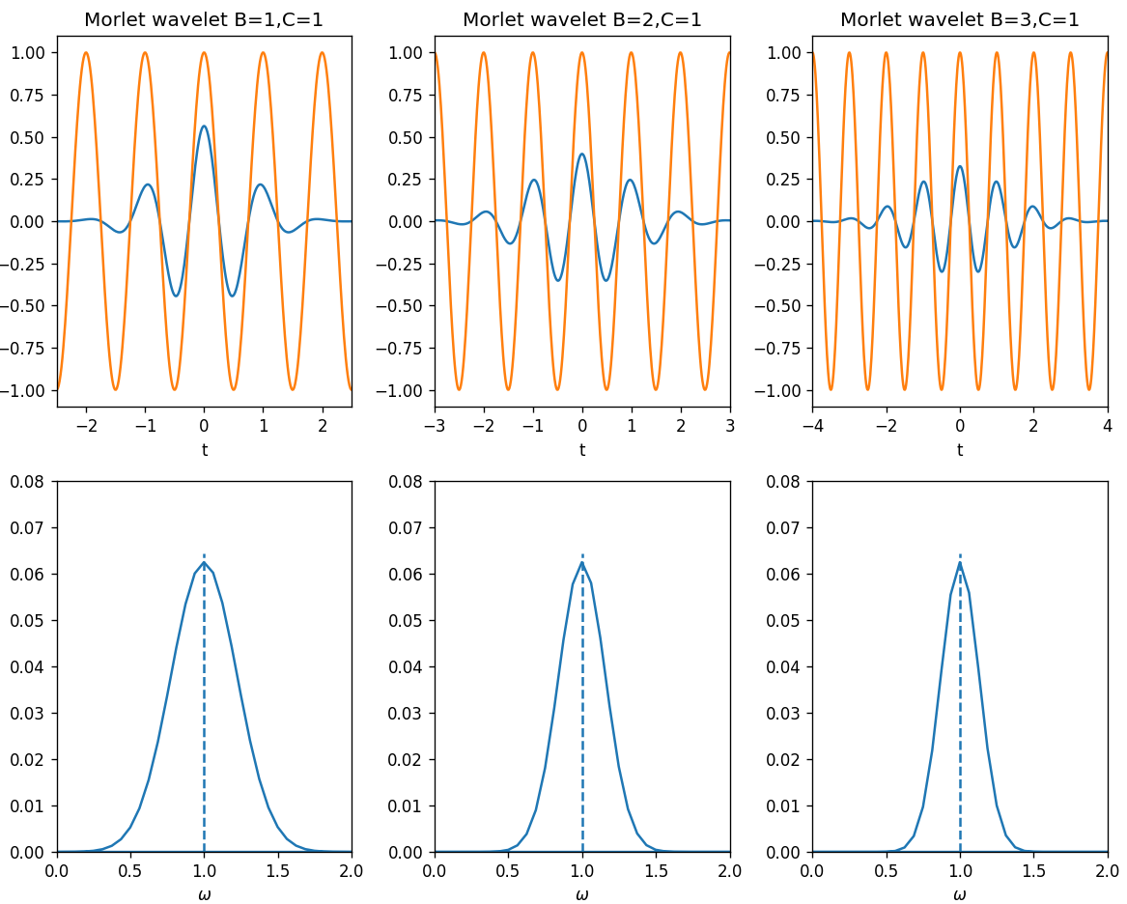
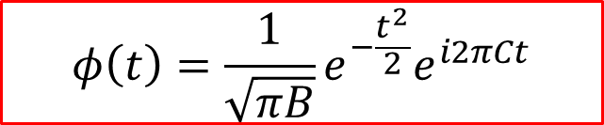
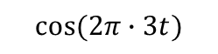
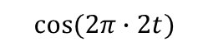
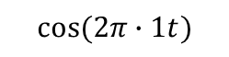
Parameters in Morlet wavelet
$$φ\left(t\right)={\frac{1}{\sqrt{πB}}e}^{−\frac{t^{2}}{2}}e^{i2πCt}$$
Center frequency(C)
Bandwidth(B)
$$cos⁡(2π∙1t)$$
$$cos⁡(2π∙2t)$$
$$cos⁡(2π∙3t)$$
Center frequency
Notes:
When you change a, you dilate or compress φ.
Small b ⇒ compressed wavelet ⇒ high-frequency “zoom”
Large b ⇒ stretched wavelet ⇒ low-frequency “overview” Shifts the center of the wavelet along t

Slide 6
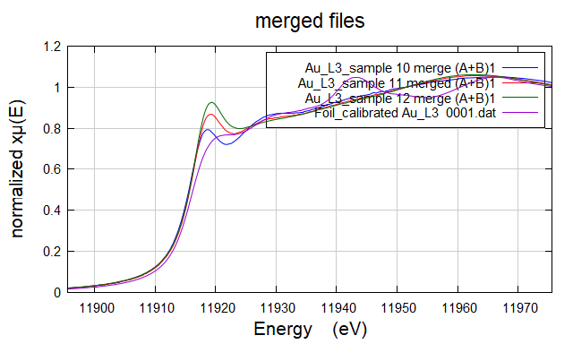
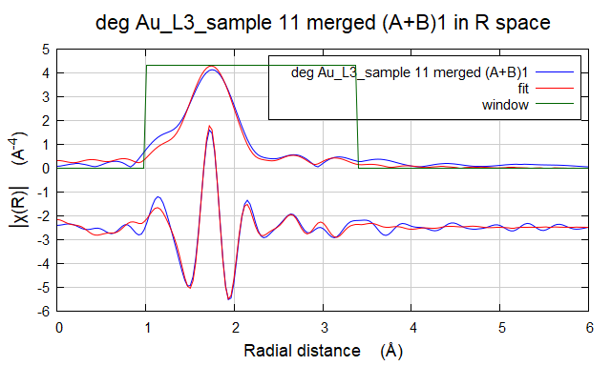
Wavelet in XAFS
Sample description :Gold nanoparticles (Au 2.5 mM) with mucin (5 mg/mL), pH 6, adjusted with NaOH, 1 hour after t₀
High uncertainty
This means the Au–Au signal is weak or buried in noise.
Fit Condition | Path | N | R (Å) | σ² (Å²) | ΔE (eV)
Au-Au Au-S | Au-Au | 4.2 ± 3.9 | 3.004 ± 0.039 | 0.0198 ± 0.0114 | -0.24 ± 1.74
 | Au-S | 3.5 ± 0.5 | 2.221 ± 0.011 | 0.0103 ± 0.0017 | -0.24 ± 1.74
Notes:
Because gold nanoparticles has easy surface functionalization and high biocompatibility. This sample mimics how gold nanoparticles interact with a key mucus protein under different PH for different reduction time. The main purpose of this research is to explain the reduction mechanism of gold by mucin (a natural glycoprotein).
2. Try to find explanation to the empiric results that I have seen in lab, in terms of:
ph effect
Time effect
Mucin concentration
Considering size and shape of the nanoparticles.

Slide 7
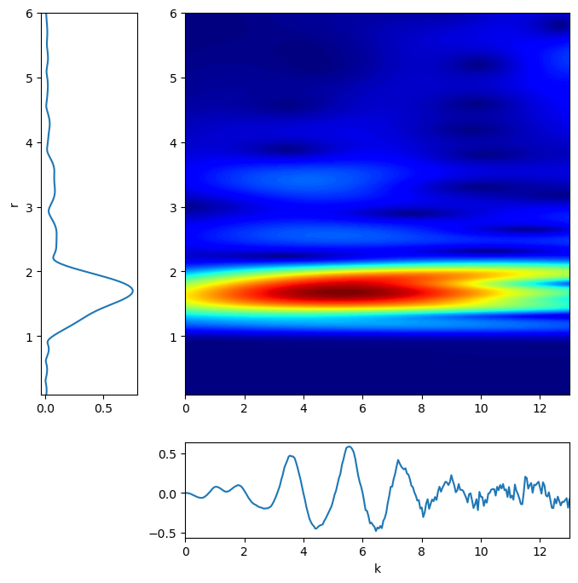
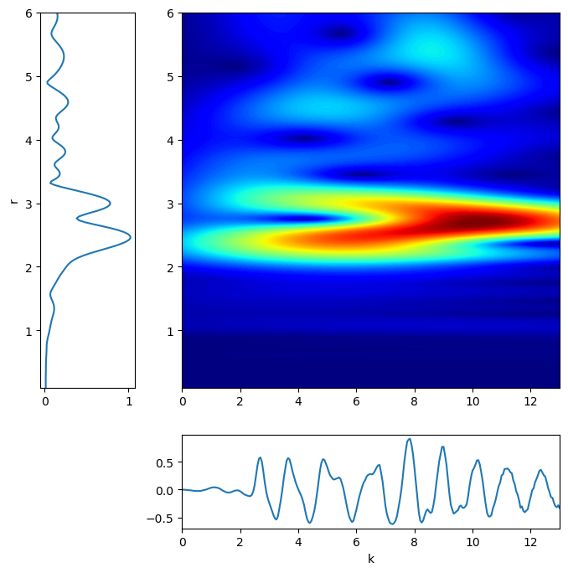
sample
Foil
There might be overlap between Au–Au bond at 3.00 Å, Au–S bond at 2.22 Å are fairly close.
Fourier Transform alone may not cleanly separate the Au–Au and Au–S contributions.
import larch
from wxmplot.interactive import plot
from larch.xafs import autobk
from larch.xafs import cauchy_wavelet
from larch.io import read_ascii,read_athena
from larch.xafs import find_e0,pre_edge,autobk,xftf,xftr
from larch import Group
import larch
import glob
import os
import glob,linecache,shutil
import numpy as np
Provides both k-space (energy) and R-space (distance) information at the same time.
cauchy_wavelet(k=group.k,chi=k2chi,group=group)
Notes:
Larch is an open-source Python library designed specifically for processing and analyzing X-ray spectroscopy data—most notably X-ray absorption spectroscopy (XAS). It provides everything from data import and pre-processing (background subtraction, normalization, Fourier transforms) to fitting (e.g. Feff-based EXAFS modeling)

Slide 8
Wavelet | What it Does | When to Use | Catch (Downside)
Cauchy | Picks up big, broad features in data. | Show overall trends, not fine details. | Blurs close features together — can't tell them apart clearly.
Morlet | Balances details and big features — a good middle ground. | Decent detail in both frequency (k) and distance (R). | It’s a compromise — not super sharp in either k or R.
Paul | Zooms in very narrowly on a tiny slice of data. | Good for finding weak heavy atom signals buried in noise. | So focused in k that it smears nearby features in R.
Shannon | Cuts off everything outside a chosen range sharply (like a strict filter). | Isolate and study only one part of data (cutting out noise). | Creates sharp edges that can cause weird distortions in the result.
wavelets = {
'Morlet (cmor5-1)': 'cmor5-1',
'Shannon (shan)': 'shan',
'Paul (paul)': 'cgau4',
'Mexican-Hat (mexh)': 'mexh',
}
# Loop and plot one figure per wavelet
for title, wavename in wavelets.items():
scales, max_scale = np.arange(1, 4096), 4096
coef, freqs_cwt = pywt.cwt(k**2 * chi, scales, wavename, sampling_period=dk)
R_cwt = np.pi * freqs_cwt
fig = plt.figure(figsize=(8, 8), constrained_layout=True)
gs = fig.add_gridspec(2, 2,
width_ratios =[1.2, 4],
height_ratios=[4, 1],
wspace=0.08, hspace=0.08)

Slide 9
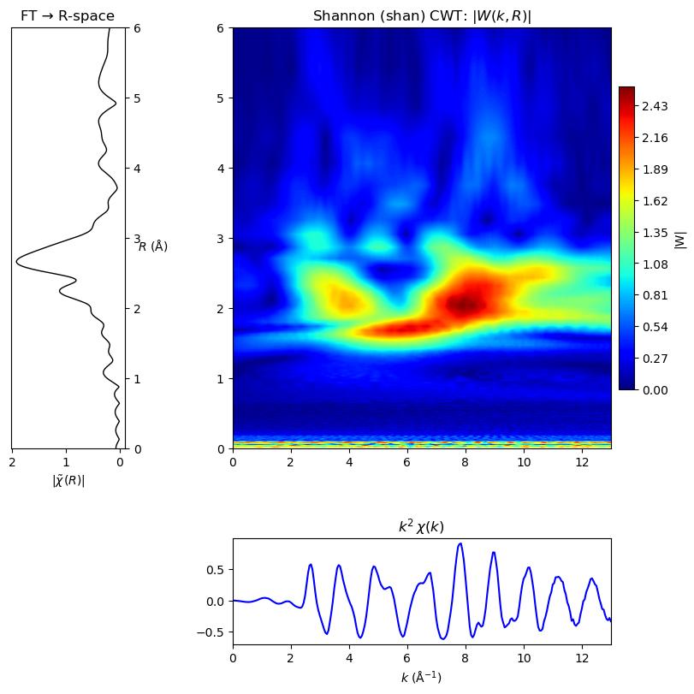
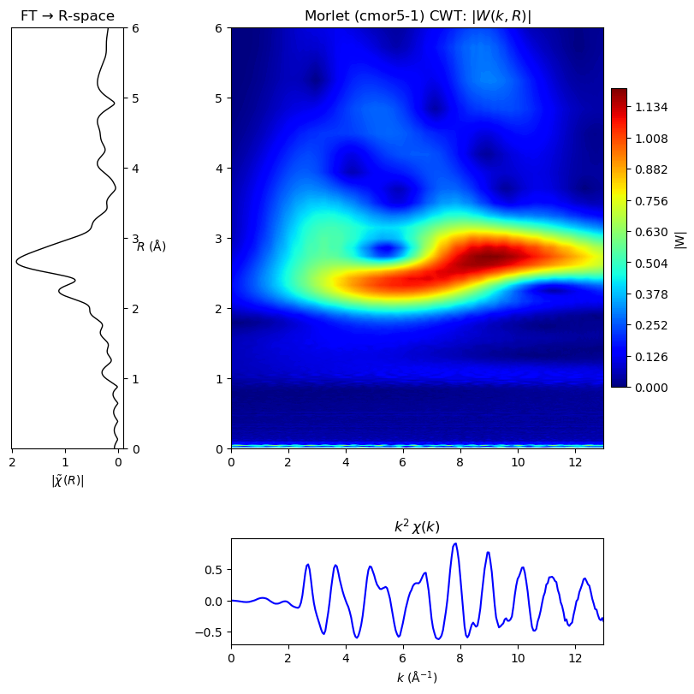
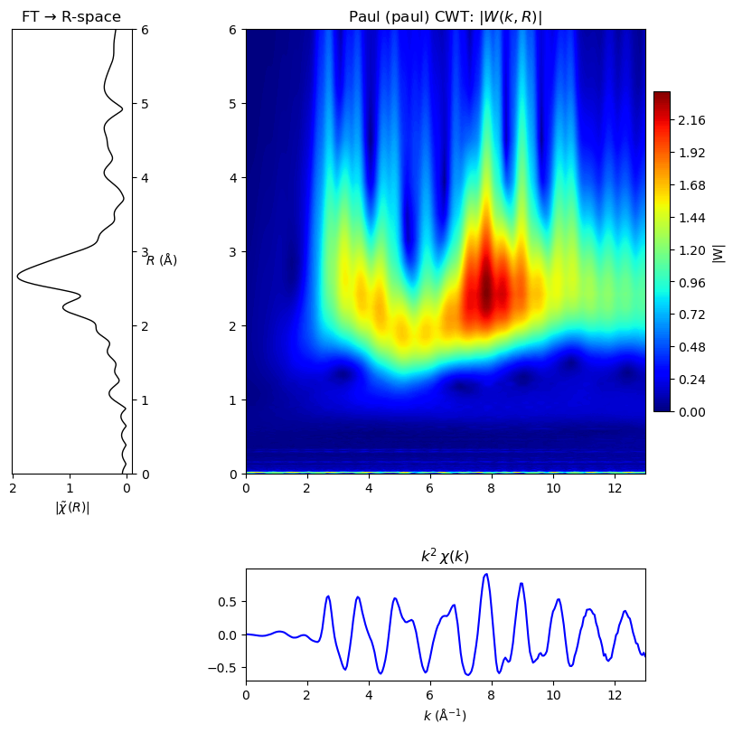
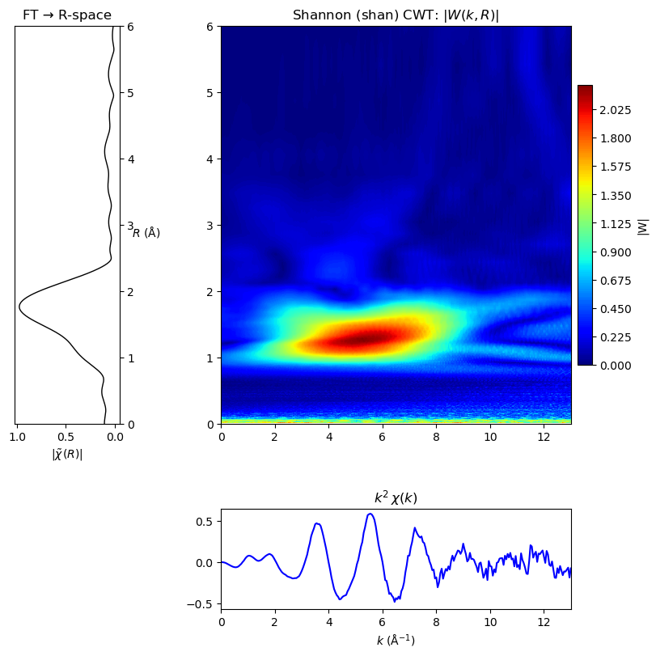
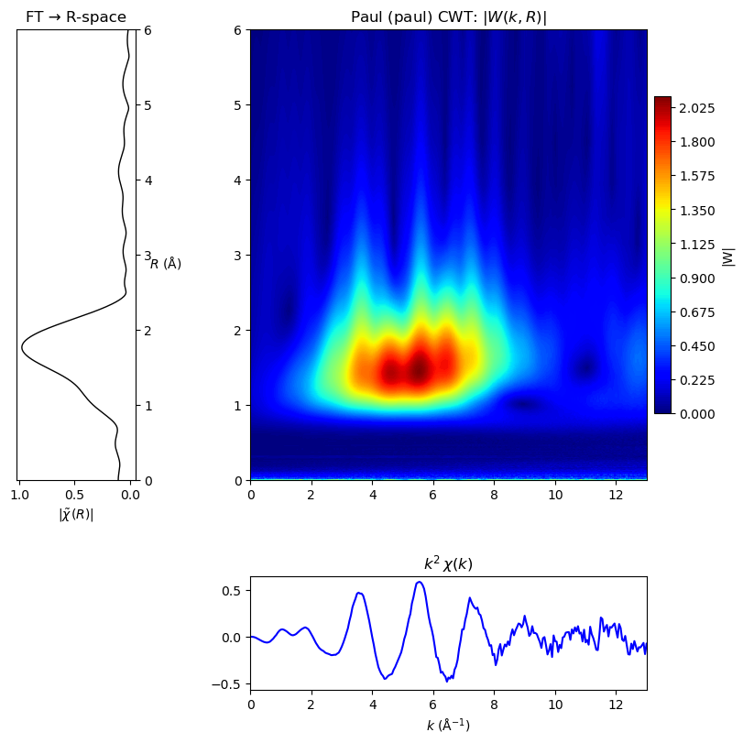
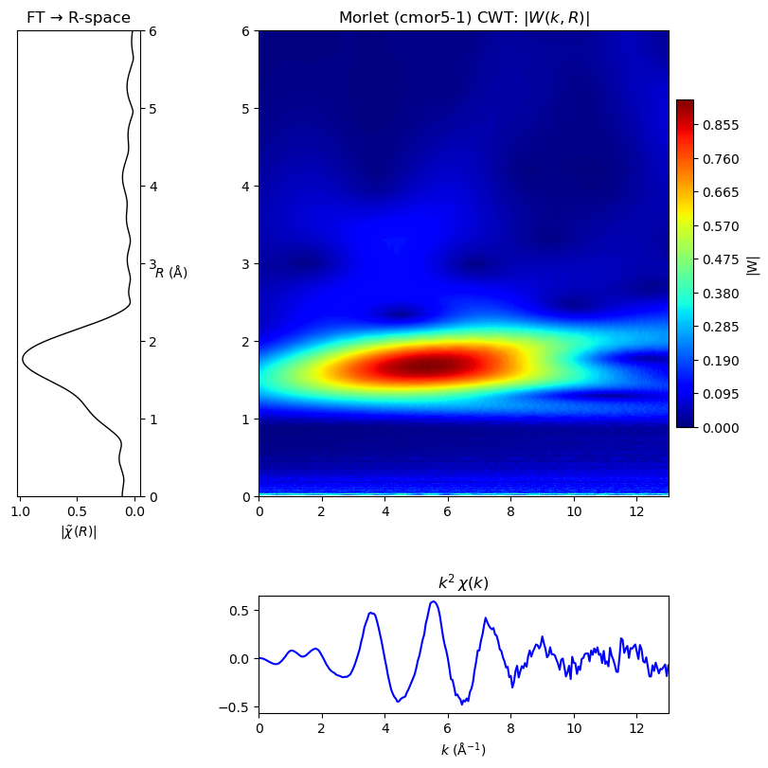
Foil
sample
Notes:
We’re comparing the Fourier‐transformed R-space (left) with continuous wavelet transforms (CWT) using Shannon, Morlet and Paul wavelets for both the foil (top row) and our nanoparticle sample (bottom row). This is a finger printing method. And it confirms lack of Au-Au contribution in signal.

Slide 10
Conclusion
Key Variables Under Study
pH effect
Incubation time
Mucin concentration
Preliminary Findings (Samples 1–12)
Higher mucin concentration and longer incubation →
Increased Au–Au bond contribution
For most samples there were no Au-Au contribution
Next Steps (Next Cycle)
Extend reduction time to 12 h, 24 h, 48 h

Slide 11
Thank you
https://youtu.be/jnxqHcObNK4?si=EaKTkuABNSlPpUvo

